Slide 1
Trilinos Introduction and Overview
Curtis Ober
Trilinos Product Owner
May 7th, 2025
HPSF Conference, Chicago, IL
SAND2025-05380C

Slide 2



Trilinos Users-Developers Group Meeting
Welcome to the TUG Meeting at the HPSF Conference!
Shifting to meet regularly at the HPSF Conference
Participant in HPSF opportunities/goals
“High-Performance Software Foundation (HPSF) aims to build, promote, and advance a portable core software stack for HPC by increasing adoption, lowering barriers to contribution, and supporting development efforts.”
Meet with other HPSF projects to broaden collaboration
Introduce Trilinos to new developers and users
Coordinating with EuroTUG
EuroTUG is moving to a bi-annual schedule
Next meeting is planned for Spring/Summer of 2026
Focused “Sandia Trilinos” meeting will occur in October
Notes:
SIAM PP in March 2026 in Berlin?
WCCM in July 2026 in Munich?
ISC in May 2026 in Hamburg?

Slide 3
Trilinos background
"The Trilinos Project is an effort to facilitate the design, development, integration and ongoing support of mathematical software libraries within an object-oriented framework for the solution of large-scale, complex multi-physics engineering and scientific problems. Trilinos addresses two fundamental issues of developing software for these problems: (i) Providing a streamlined process and set of tools for development of new algorithmic implementations and (ii) promoting interoperability of independently developed software."
Heroux, et al, "An Overview of the Trilinos Project", ACM Transactions on Mathematical Software, Vol. V, No. N, December 2004, Pages 1–27.
"The Trilinos project was established to address two important needs: (1) bringing teams of library developers together in order to leverage commonalities and produce compatible software components, formally called packages and (2) to amortize the cost and efforts associated with more formal software engineering requirements. With a modest level of coordination and without unduly compromising package team autonomy, Trilinos project members could leverage each other’s efforts, consolidate commonly needed tools, make packages compatible, and define a common set of software engineering tools and processes."
Heroux and Willenbring, "A new overview of the Trilinos project", Scientific Programming 20 (2012) 83–88

Slide 4
Trilinos
… is a community of developers, users and user-developers
… is open-source software with a modular design
… promotes collaborative algorithm and technology development
… provides a comprehensive suite of mathematical libraries
… provides interoperable, scalable, and high-performance software packages
… enables rapid development of robust, efficient algorithms
… targets new and emerging HPC architectures
… facilitates development of large-scale, complex multi-physics problems
… is used in computational fluid dynamics, structural mechanics, electromagnetics, and many more

Slide 5
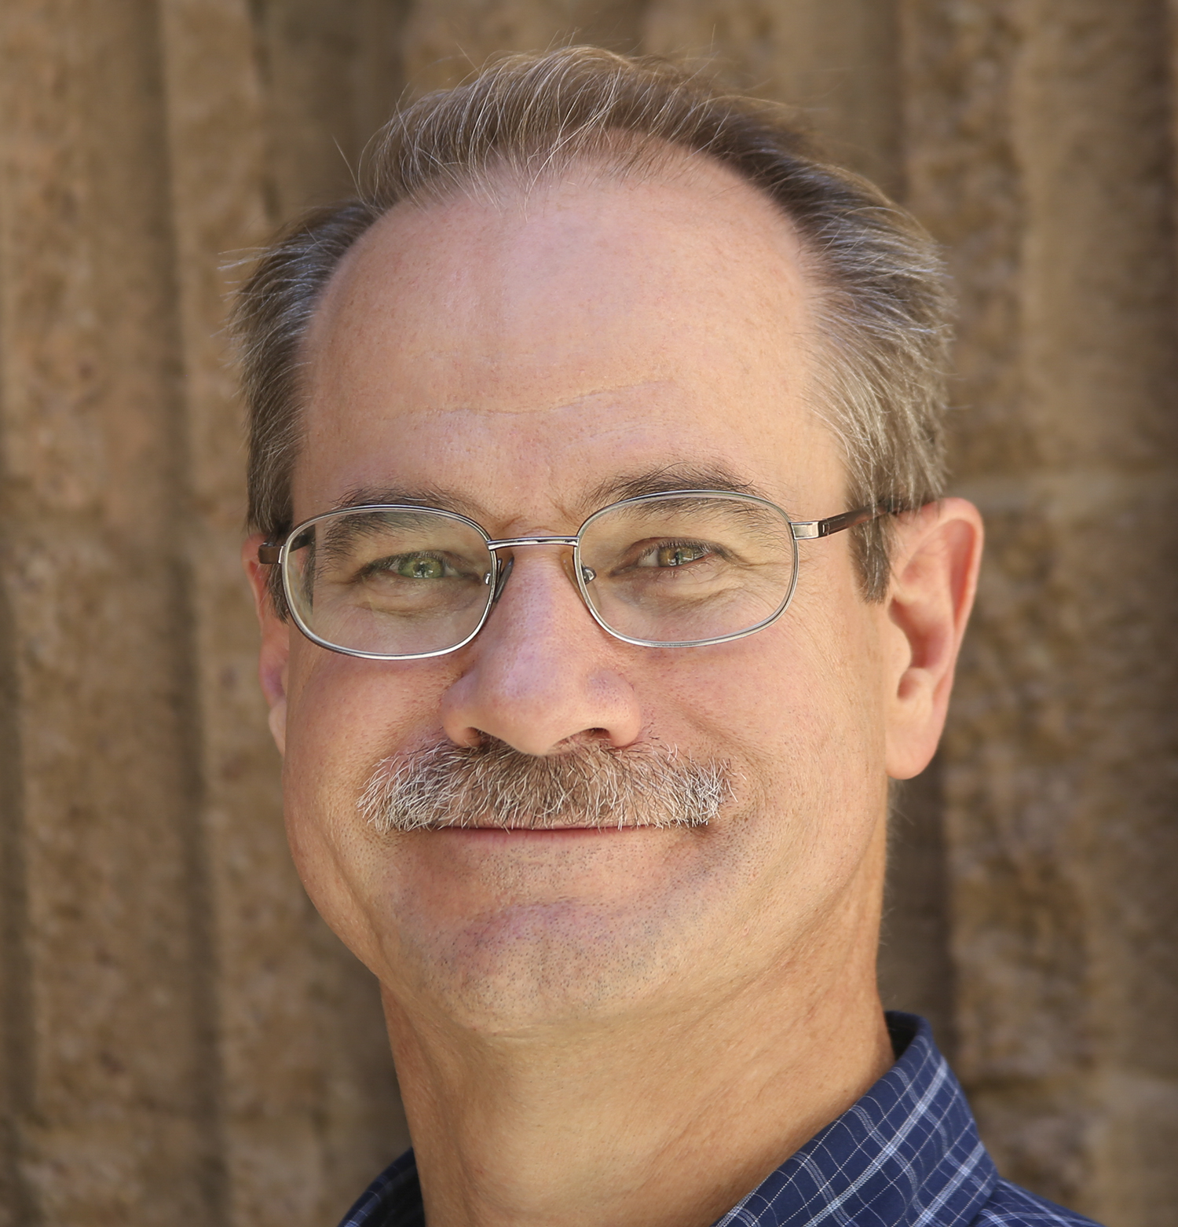
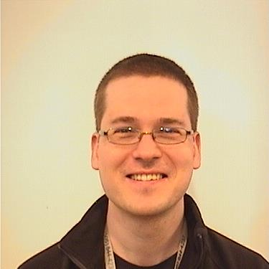
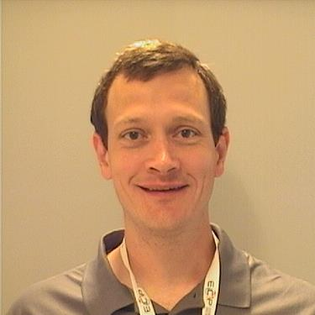
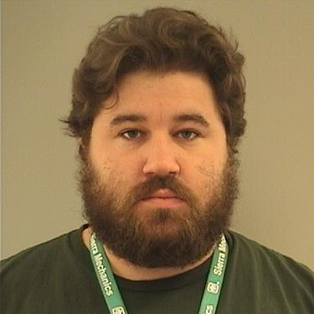
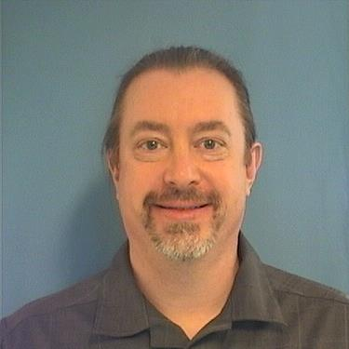
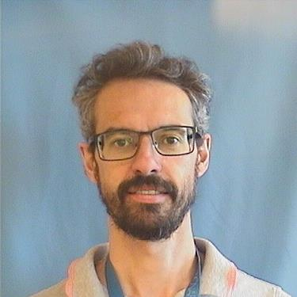
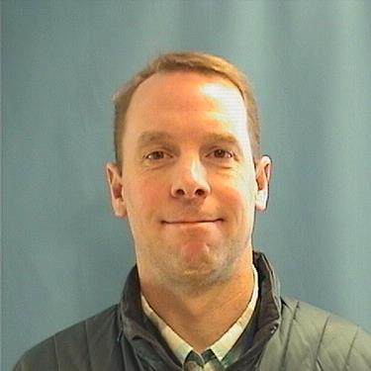
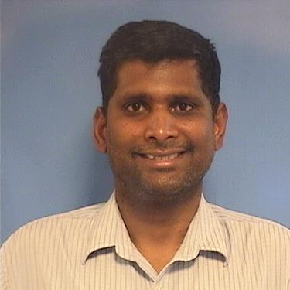
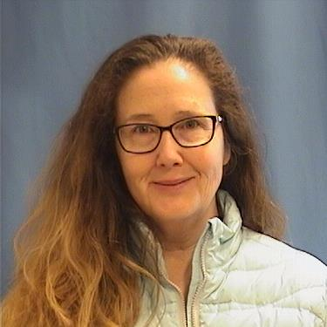
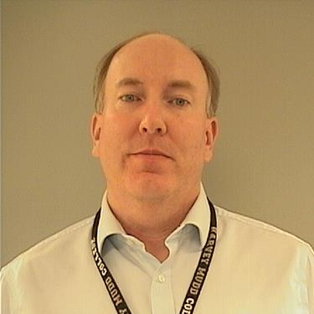
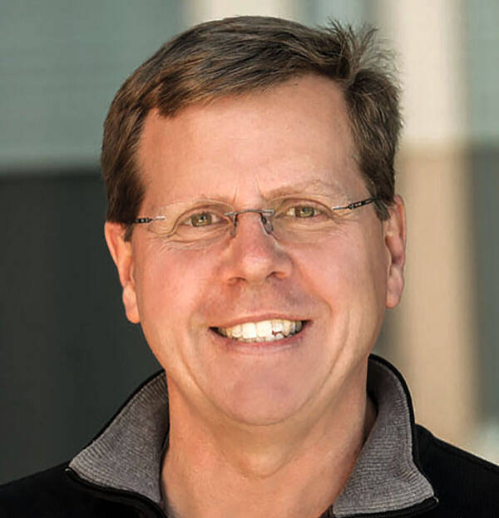
Trilinos Leadership
New Members
Curtis Ober
Trilinos Representative to TAC
Trilinos Product Owner
Trilinos Developer (Tempus)
Christian Glusa
Sandia Trilinos Strategic Lead
Trilinos Developer (Teko, MueLu, …)
Jim Willenbring
Sandia Representative to TAC
Trilinos Developer
Former Trilinos Framework Lead
Technical Steering Committee
Responsible for Trilinos-wide decisions
Determine project wide rules
Decide on package inclusion
Form committees to address tasks
Previous Members
Thank you for serving!
Sam Browne
Christian Glusa
Curtis Ober
Roger Pawlowski
Mauro Perego
Mike Heroux
Eric
Phipps
Siva
Rajamanickam
Heidi
Thornquist
Jim
Willenbring
Michael
Wolf

Slide 6
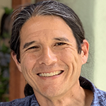
Trilinos Areas
DevSecOps:
Discretization and
Analysis Area:
Finite Element Assembly
(Intrepid2, Panzer, Shards)
DAG-based Field Eval. (Phalanx)
Mesh Methods & Structure
(Krino, Percept, STK)
Automatic Differentiation (Sacado)
Optimization Methods (ROL)
Stochastic Galerkin UQ (Stokhos)
Time Integration (Tempus)
Nonlinear Anal. Drivers (Piro)
Small Tensor Alegra (MiniTensor)
Meshless Discretization (Compadre)
Coupled Physics Examples (TrilinosCouplings)
Mauro Perego
Sam Browne
Solvers Area:
Solver Interface (Stratimikos)
Nonlinear Solvers (NOX)
Krylov Solvers (Belos)
Eigen Solvers (Anasazi)
Direct Sparse & Dense Solvers (Amesos2, Adelus)
Block Solvers (Teko)
Multigrid Methods (MueLu)
Multilevel Domain Decomposition Methods (ShyLU)
Iterative Substructuring (ShyLU)
Overlapping Schwarz (ShyLU/FROSch)
Jonathan Hu
Polynomial Smoothers, SOR, ILU (Ifpack2)
Linear Factorization
(KLU, ShyLU/Basker)
Cholesky and LDL Factorizations (ShyLU/Tacho)
Core Area:
Python Interface (PyTrilinos2)
Abstract Numerical Algorithms & Interfaces (Thyra)
Mesh Generation (Simple Shapes) (Pamgen)
Matrix Generation Tools (Galeri)
Vector Reduction/Transformation Operators (RTOp)
Distributed Linear Algebra
(Tpetra)
Load balancing and partitioning
(Zoltan/Zoltan2)
Finite Element Utilities (SEACAS)
Roger Pawlowski
Common SE Utilities (Teuchos)
Optimized Math Kernels (Kokkos Kernels)
Performance Portability (Kokkos)

Slide 7
Core Area - provides basic capabilities
Roger Pawlowski
Algebra/Numerics | Description | Package Lead
Kokkos (@kokkos) | Performance portability library | Christian Trott (@crtrott)
Kokkos Kernels (@kokkos-kernels) | Optimized math kernels for Kokkos library | Luc Berger-Vergiat (@lucbv)
RTOp (@rtop) | Vector Reduction/Transformation Operators | Ross Bartlett (@bartlettroscoe)
Thyra (@thyra) | Abstract numerical algorithms and interfaces | Ross Bartlett (@bartlettroscoe)
Tpetra (@tpetra) | Distributed linear algebra objects | Chris Siefert (@csiefert2)
Utilities
Galeri (@galeri) | Matrix generation tools | Jonathan Hu (@jhux2)
PyTrilinos2 (@pytrilinos2) | Python bindings for Trilinos packages | Christian Glusa (@cgcgcg)
SEACAS (@SEACAS) | Utilities supporting finite element analysis | Greg Sjaardema (@gsjaardema)
Teuchos (@teuchos) | Common tools (smart pointers, parameter lists, …) | Roger Pawlowski (@rppawlo)
Meshing / Domain Decomposition
Pamgen (@pamgen) | Mesh generation tools for simple shapes | Roger Pawlowski (@rppawlo)
Zoltan/Zoltan2 (@zoltan, @zoltan2) | Load balancing and partitioning | Erik Boman (@egboman)

Slide 8
Solvers Area - provides linear and nonlinear Solvers
Jonathan Hu
Linear / Nonlinear Solvers | Description | Package Lead
Adelus (@adelus) | Scalable dense linear solvers | Vinh Dang (@vqd8a)
Amesos2 (@Amesos2) | Direct sparse solvers | Siva Rajamanickam (@srajama1)
Belos (@belos) | Iterative linear solvers | Heidi Thornquist (@hkthorn)
NOX (@nox) | Nonlinear solvers | Roger Pawlowski (@rppawlo)
ShyLU (@shylu) | Hybrid linear solvers | Siva Rajamanickam (@srajama1)
Preconditioners
Ifpack2 (@ifpack2) | Preconditioners | Jonathan Hu (@jhux2)
MueLu (@muelu) | Multigrid solvers | Jonathan Hu (@jhux2)
Teko (@teko) | Block preconditioners | Malachi Phillips (@MalachiTimothyPhillips)
Others
Anasazi (@anasazi) | Eigenvalue solvers | Heidi Thornquist (@hkthorn)
Stratimikos (@stratimikos) | Solver and preconditioner wrappers | Ross Bartlett (@bartlettroscoe)
Xpetra (@xpetra) | Linear algebra interfaces | Jonathan Hu (@jhux2)

Slide 9
Discretization and Analysis - modular, interoperable and extensible tools
Mauro Perego
Compadre (@Compadre) | Toolkit for meshless discretizations | Paul Kuberry (@Paul Kuberry)
Intrepid2 (@Intrepid2) | High-order compatible finite elements | Mauro Perego (@mperego)
Krino (@krino) | Meshing tool with level-set methods | David Noble (@drnobleabq)
MiniTensor | Algebra for small vectors/tensors | Alejandro Mota (@lxmota)
Panzer (@panzer) | Finite element analysis and assembly | Roger Pawlowski (@rppawlo)
Percept (@percept) | Mesh adaptation and data transfer | Brian Carnes (@bricar)
Phalanx (@phalanx) | DAG-based local field evaluation kernel | Roger Pawlowski (@rppawlo)
Piro (@piro) | Driver classes for common nonlinear analysis | Mauro Perego (@mperego)
ROL (@rol) | Large-scale optimization algorithms | Denis Ridzal (@Denis Ridzal)
Sacado (@Sacado) | Automatic differentiation | Eric Phipps (@Eric Phipps)
Shards (@shards) | Finite element topologies | Mauro Perego (@mperego)
STK (@STK) | Scalable mesh data structures | Alan Williams (@alanw0)
Stokhos (@Stokhos) | Stochastic Galerkin UQ methods | Eric Phipps (@Eric Phipps)
Tempus (@tempus) | Time Integration | Curtis Ober (@ccober6)
TrilinosCouplings (@trilinoscouplings) | Coupled physics examples | Mauro Perego (@mperego)

Slide 10
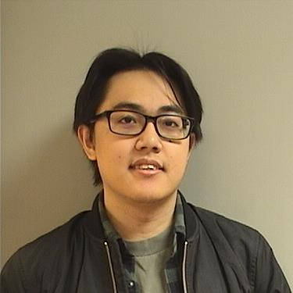
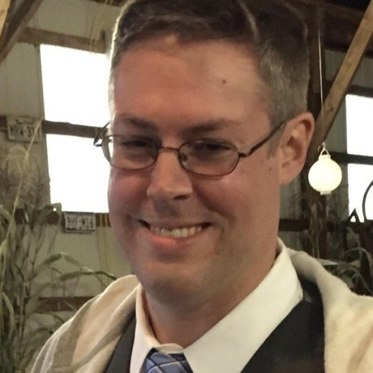
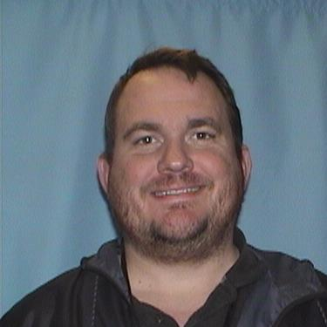
DEV Sec Ops – Supports daily Operations and CI/CD
Sam Browne
Provides streamlined processes and set of tools for development of Trilinos packages
Implements various development, testing, automation tools, and IT infrastructure
Defines and sets development, test, release, update, and support processes
Organizes and maintains Trilinos release process
Leads DevSecOps team in performing associated tasks
Anderson Chauphan
Justin LaPre
Joe Frye

Slide 11
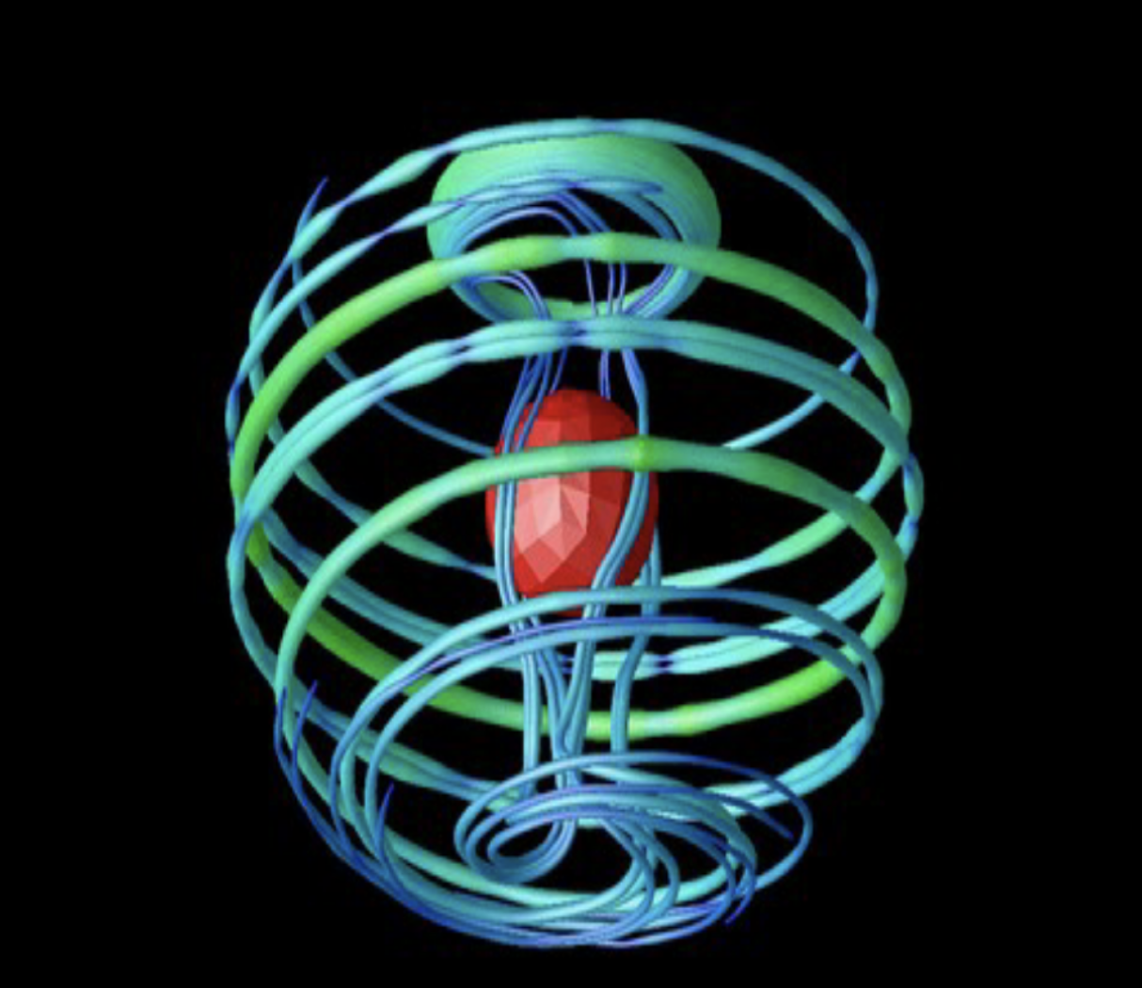

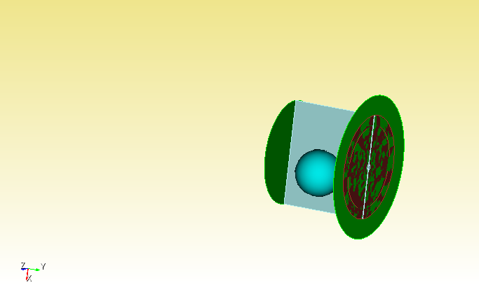


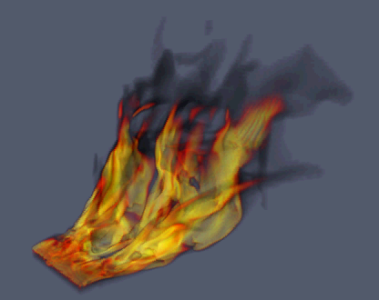
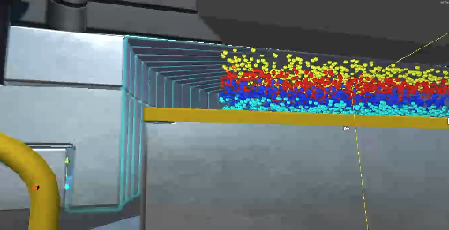

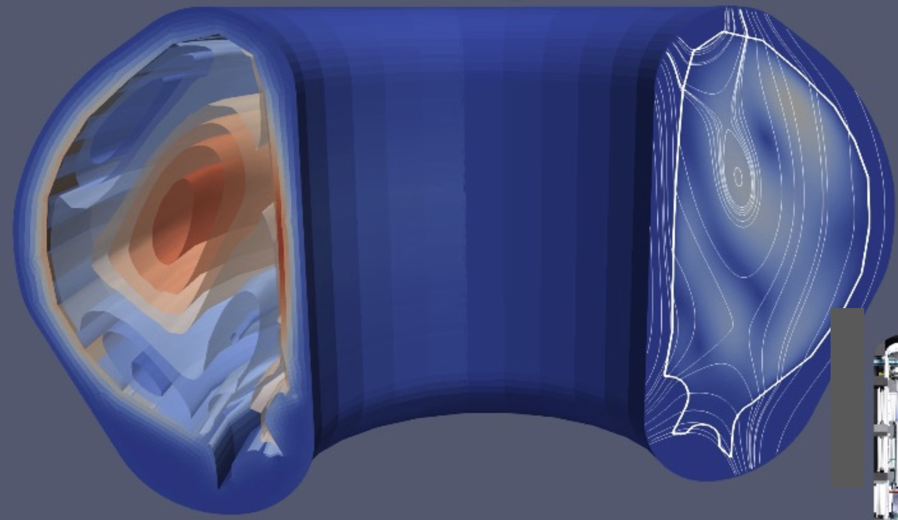

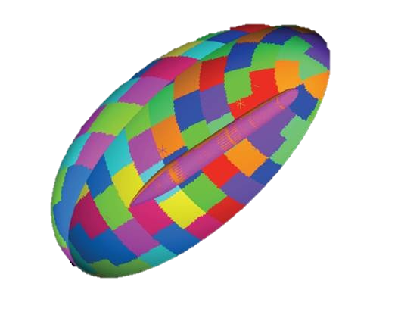
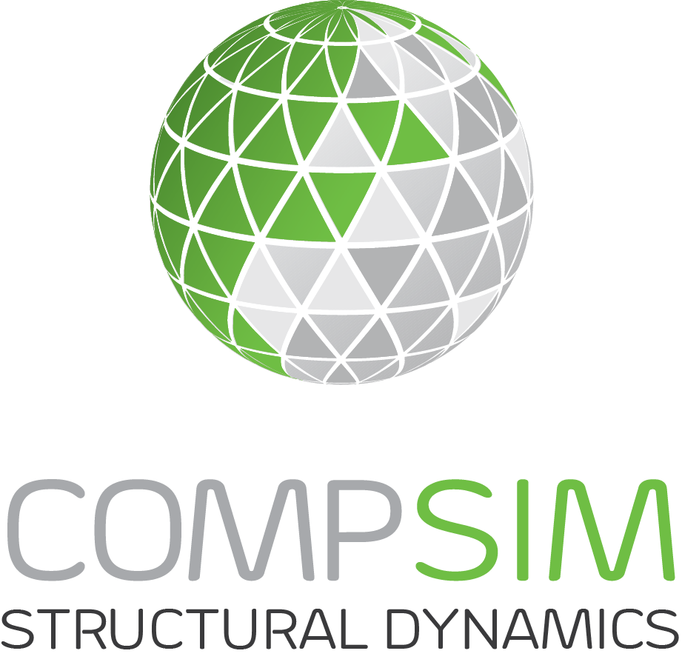
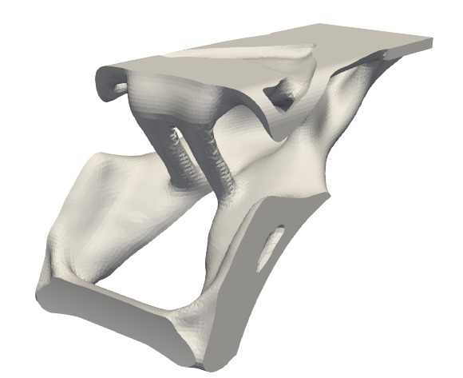



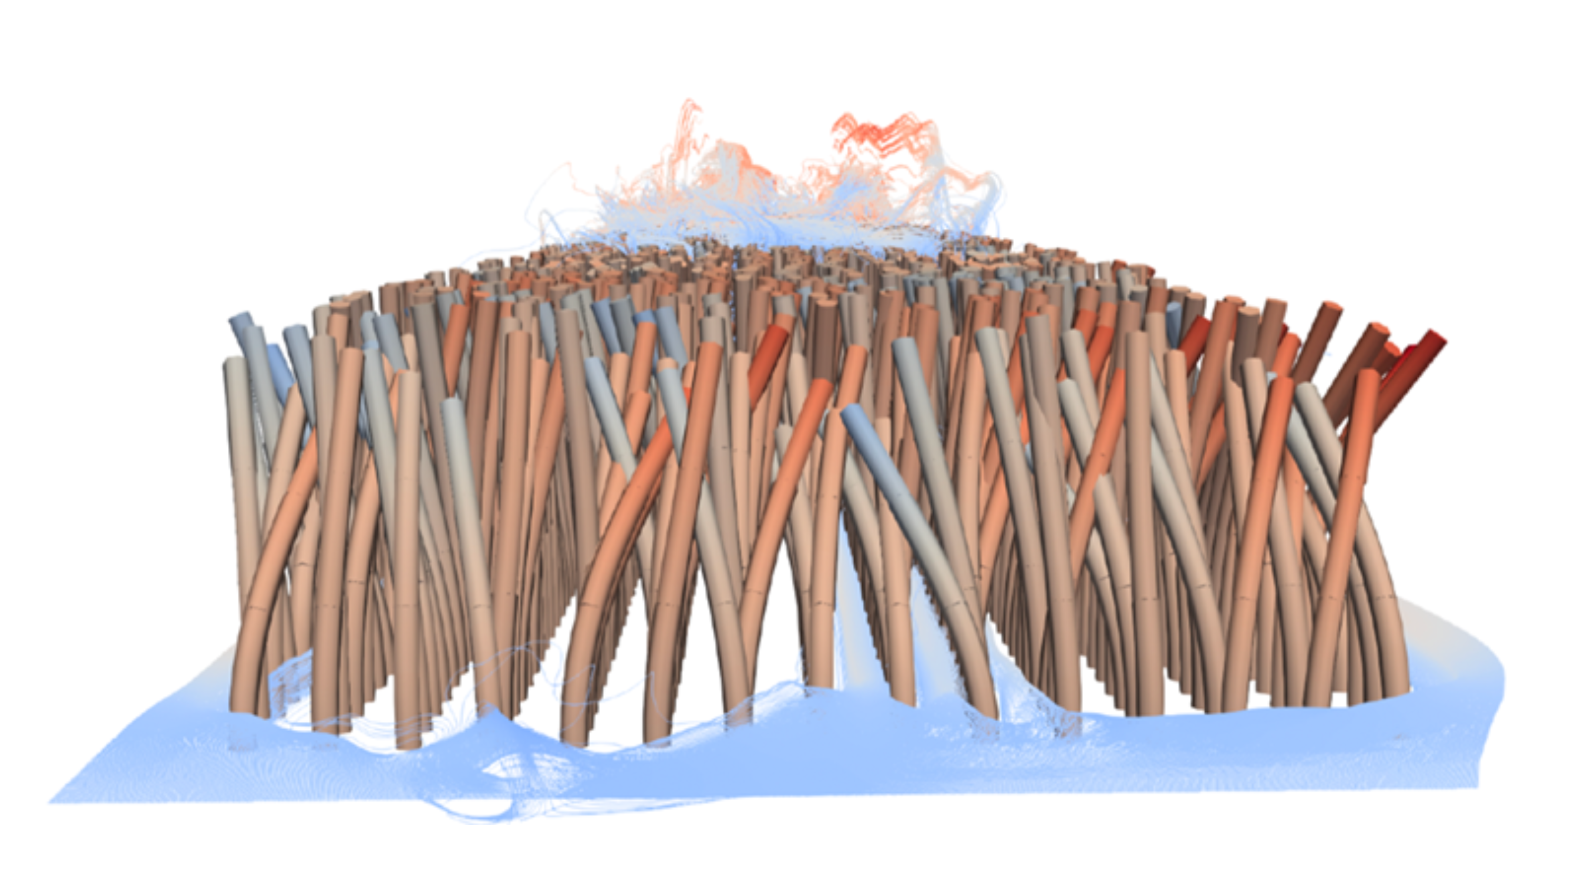
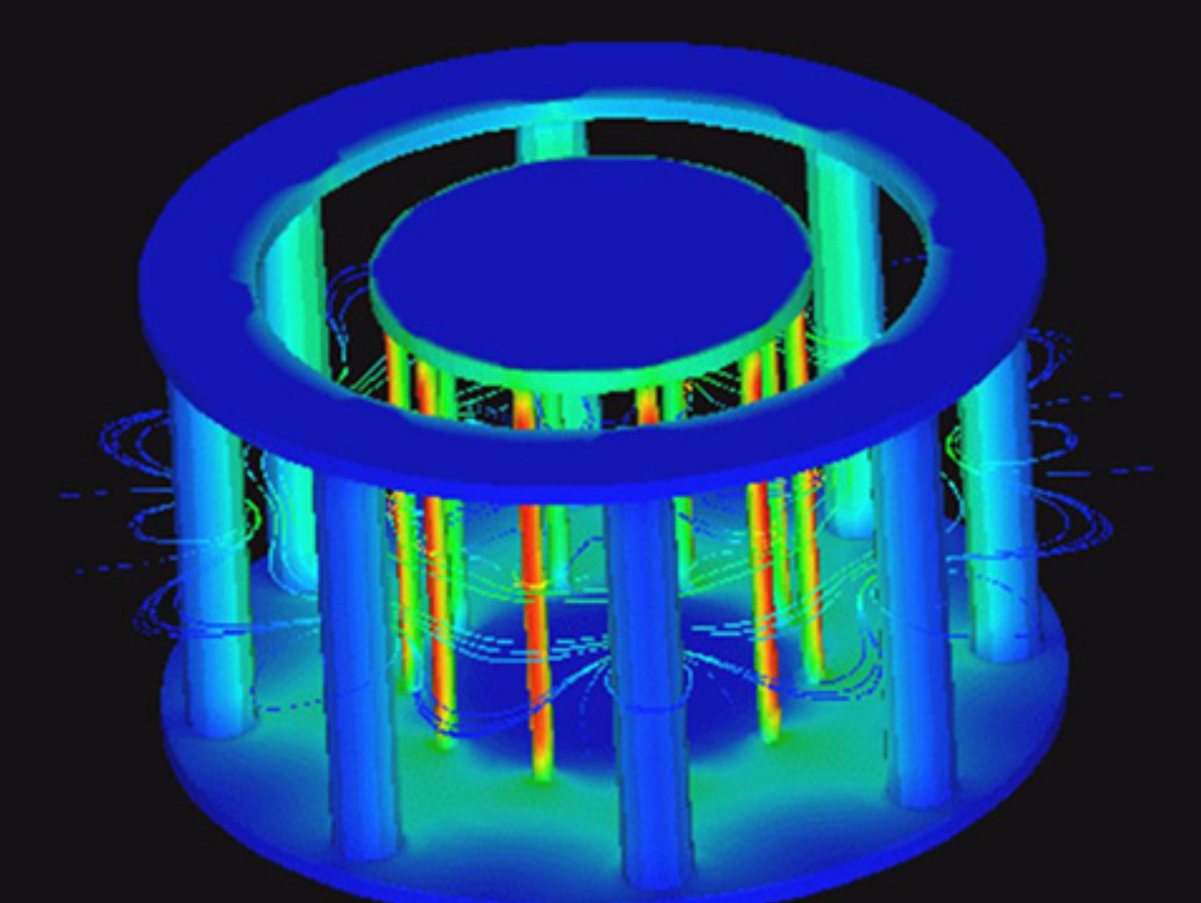
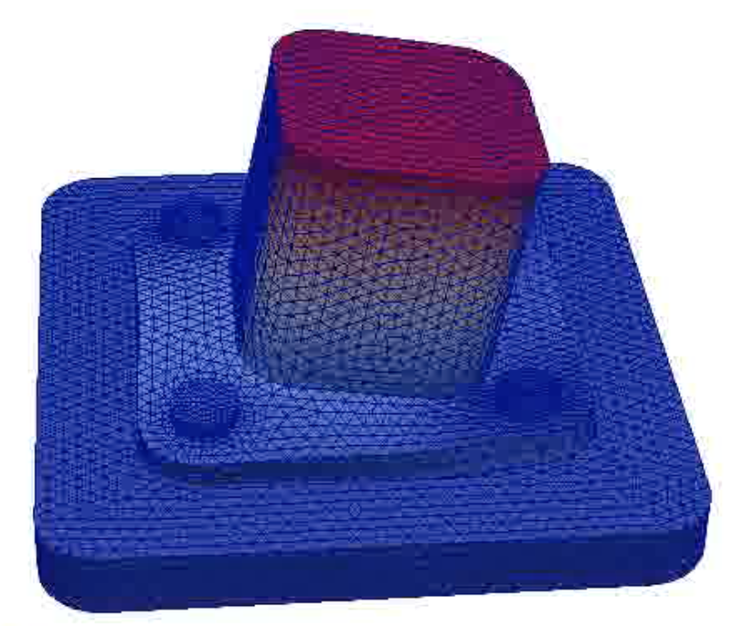
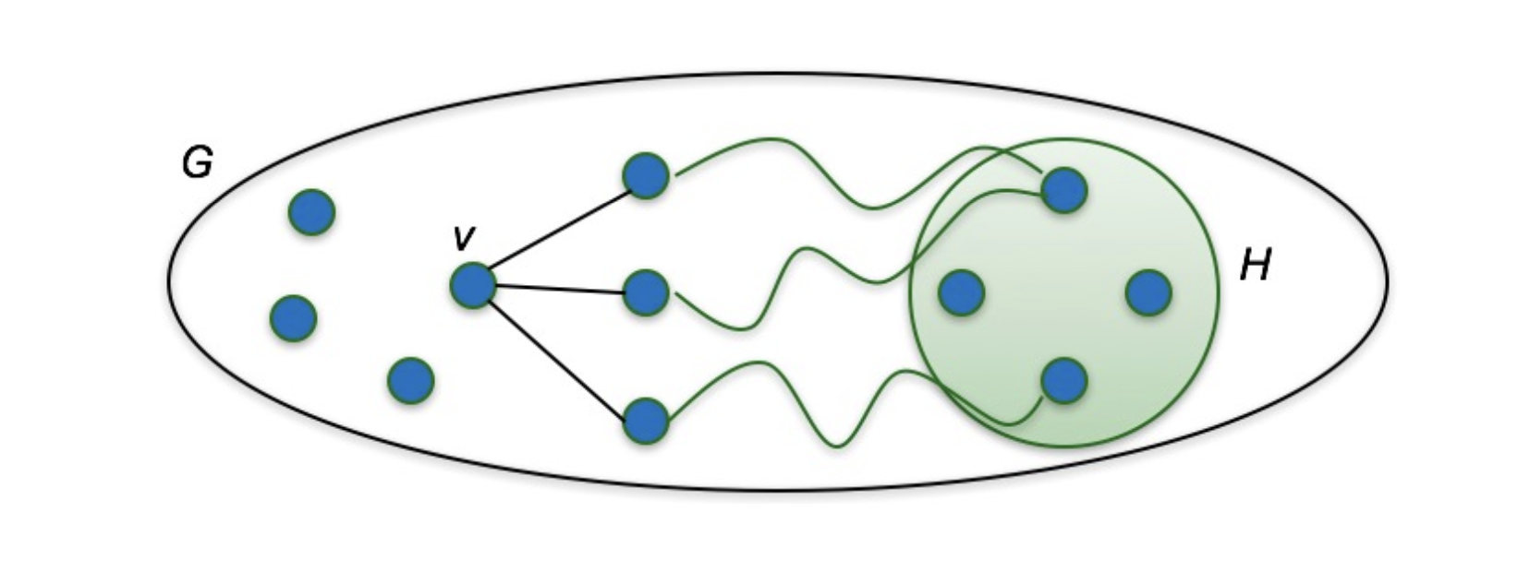
Collaborations with Users & Stakeholders
Trilinos currently has collaborations with ~25 applications …
deal.II
Rapid development of modern finite element codes
2D-3D Compressible CFD
Gemma
High-fidelity, robust, solutions for Maxwell’s Equations
Credible full-system virtual flight-testing platform for hypersonic vehicles
Drekar
Heat Transfer, Thermal Radiation, Chemistry, Multiphase flow, Fire/Combustion
Plasma simulations over a broad density ranges
Plasma Confinement, Tokamak Instabilities / Disruptions
High-performance analog circuit simulator
Vibration Calculations for Structural Dynamics
Semiconductor device modeling
4C Comprehensive Computational Community Code
Grafiki
Alegra
Finite element code for the solution and analysis of multi-physics problems
High-Performance Distributed
Graph-based Algorithms
Shock hydrodynamics and multi-physics
Multi-physics research code for a plethora of computational mechanics
11

Slide 12
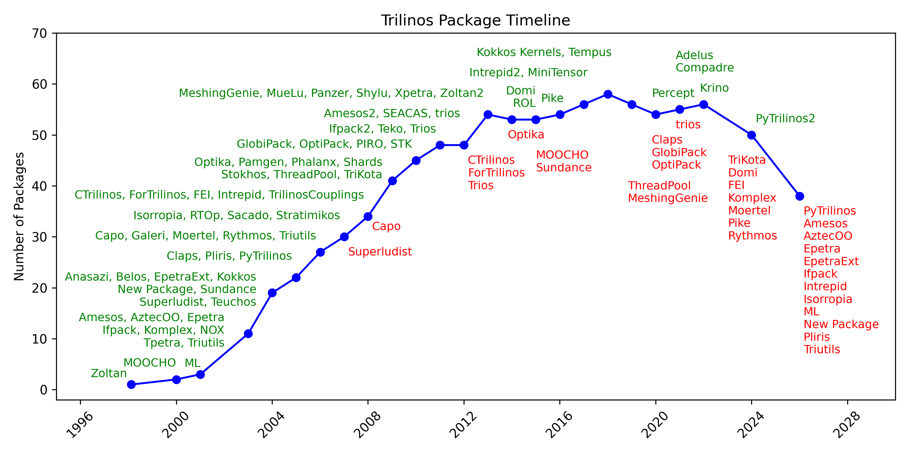
Trilinos Package history
Epetra Deprecation
PyTrilinos2
Amesos2
Stratimikos
Tpetra
Ifpack2
Intrepid2
Zoltan/Zoltan2
MueLu
Adelus
Peak: 58 packages
FY2026: 38 packages

Slide 13
Epetra Removal – SEPT. 2025!
Deprecated Epetra Stack
Amesos
AztecOO
Epetra
EpetraExt
Ifpack
Intrepid
Isorropia
ML
New Package
Pliris
PyTrilinos
ThyraEpetraAdapters
ThyraEpetraExtAdapters
Triutils
ShyLU_DDCore
Dependent on Epetra
Amesos2
Anasazi
Belos
Galeri
MueLu
NOX
PanzerDiscFE
PanzerDofMgr
Piro
ROL
ShyLU_DDFROSch,
Teko
TpetraCore
TrilinosCouplings
Stokhos
Stratimikos
Xpetra
Zoltan2Core
Epetra/Tpetra has been around for 20+ years
Many applications have been dependent on Epetra
Driver for deprecation
Reduce costs of duplicative code
Reduce complexity of Trilinos DAG
Deprecated packages will be moved from the Trilinos repo to individual package repos
If you are still using
Deprecated packages, transition to Tpetra packages ASAP.
Dependent packages,
Build and test without Epetra
Test capabilities for functionality/performance

Slide 14
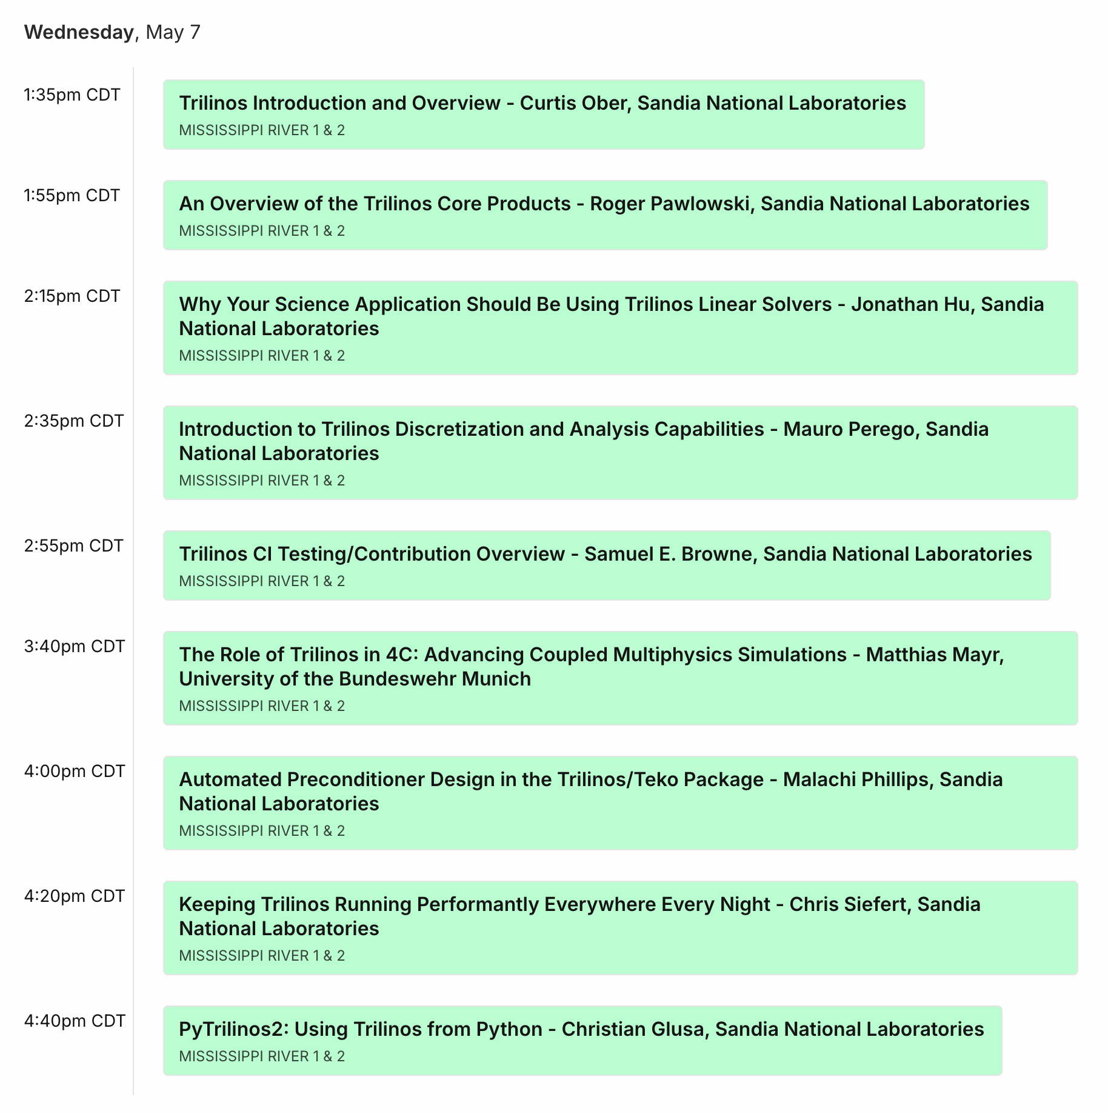
Trilinos Users-Developers Group (TUG) Meeting
Introduction
and Area Leads
User Talks
Performance
Interface Demo

Slide 15
Thanks! Any Questions?

